Slide 1
MODULE 4 -Fuzzy Inference Systems
Module - 4 (Fuzzy Inference System & Genetic Algorithm)
Fuzzy Inference Systems - Mamdani and Sugeno types. Fuzzy Logic Controller. Concepts of genetic algorithm. Operators in genetic algorithm - coding, selection, cross over, mutation. Stopping condition for genetic algorithm.

Slide 2
Fuzzy Inference Systems(FIS)
Fuzzy Inference System is the key unit of a fuzzy logic system having decision making as its primary work. It uses the “IF…THEN” rules along with connectors “OR” or “AND” for drawing essential decision rules.

Slide 3
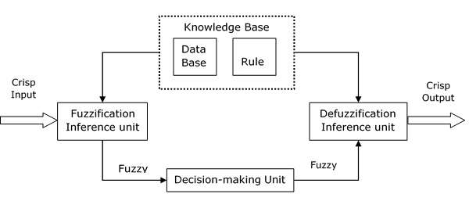
Fuzzy Inference Systems(FIS)

Slide 4
Functional block of FIS
Rule Base − It contains fuzzy IF-THEN rules.
Database − It defines the membership functions of fuzzy sets used in fuzzy rules.
Decision-making Unit − It performs operation on rules.
Fuzzification Interface Unit − It converts the crisp quantities into fuzzy quantities.
Defuzzification Interface Unit − It converts the fuzzy quantities into crisp quantities. Following is a block diagram of fuzzy interference system.

Slide 5
Fuzzy Inference Systems - Mamdani and Sugeno types.
Fuzzy Inference System (FIS) is a process to interpret the values of the input vector and, on the basis of some sets of fuzzy rules, it assigns corresponding values to the output vector. This is a method to map an input to an output using fuzzy logic. Based on this mapping process, the system takes decisions and distinguishes patterns.
There are two main types of fuzzy inference systems: Mamdani FIS and Sugeno FIS.

Slide 6
Mamdani FIS –
The Mamdani fuzzy inference system was proposed by Ebhasim Mamdani.
Firstly it was designed to control a steam engine and boiler combination by a set of linguistic control rules obtained from the experienced human operators. In Mamdani inference system, the output of each rule to be a fuzzy logic set.

Slide 7
Steps for Computing the Output
Determine a set of fuzzy rule
Make the input using input membership functions
Combine the fuzzified inputs according to the fuzzy rules for establishing a rule strength
Determine the consequent of the rule by combining the rule strength and the output membership function
Combine all the consequents to get an output distribution
Finally, a defuzzified output distribution is obtained

Slide 8
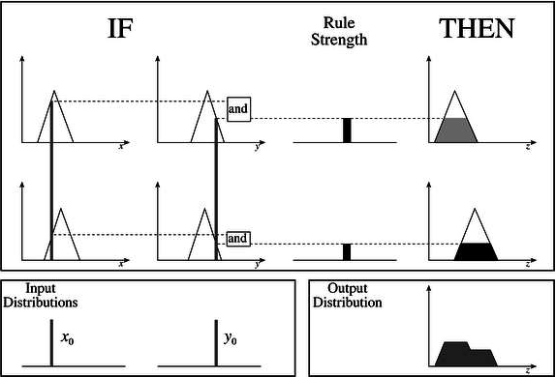

Slide 9
Sugeno FIS –
This fuzzy inference system was proposed by Takagi, Sugeno, and Kang to develop a systematic approach for generating fuzzy rules from a given input-output dataset. A typical fuzzy rule in a first-order Sugeno fuzzy model has the form:
IF x is A and y is B THEN z = f(x, y)
where
A and B are fuzzy sets in the antecedent
z = f(x, y) is a crisp function in the consequent.
Higher-order Sugeno fuzzy models are also possible, but while designing, those introduce significant complexity.

Slide 11
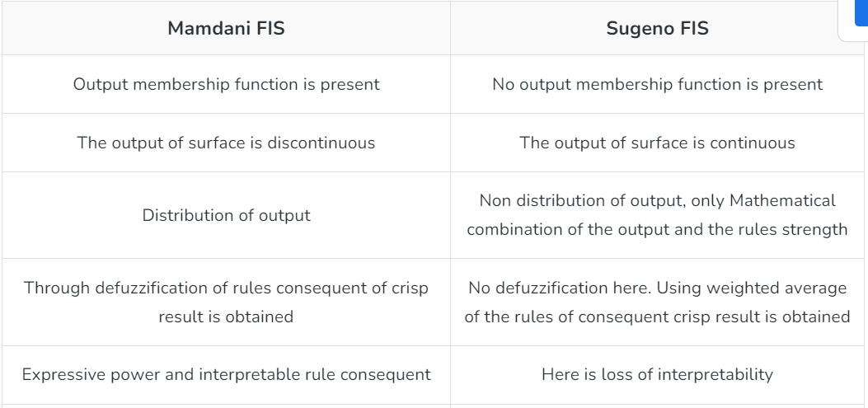

Slide 12
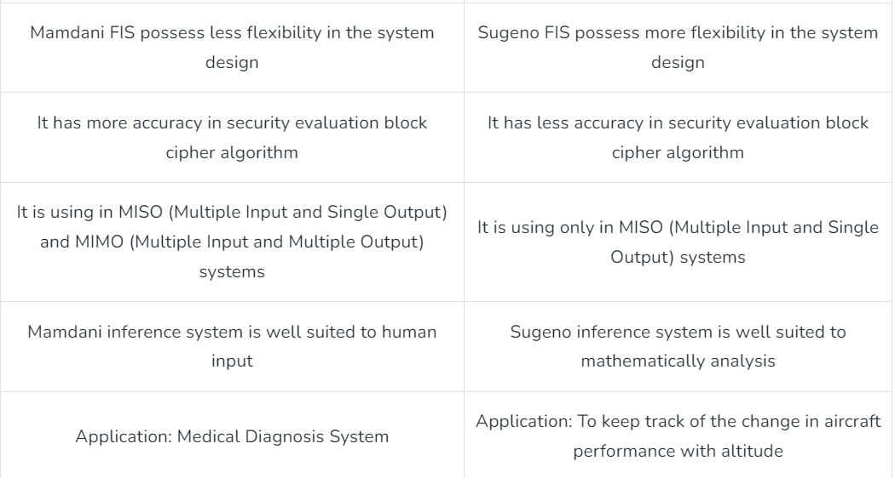

Slide 13
Advantages of Mamdani method
1. It has widespread acceptance;
2. it is well-suitable for human input;
3. it is intuitive.
Advantages of Sugeno method
1. It is computationally efficient.
2. It is compact and works well with linear technique, optimization technique and adaptive technique.
3. It is best suited for mathematical analysis.
4. It has a guaranteed continuity of the output surface

